Slide 1
MATH 3110 Project
Neural Networks
By: Brady Setser and Ryon Peddapalli

Slide 2
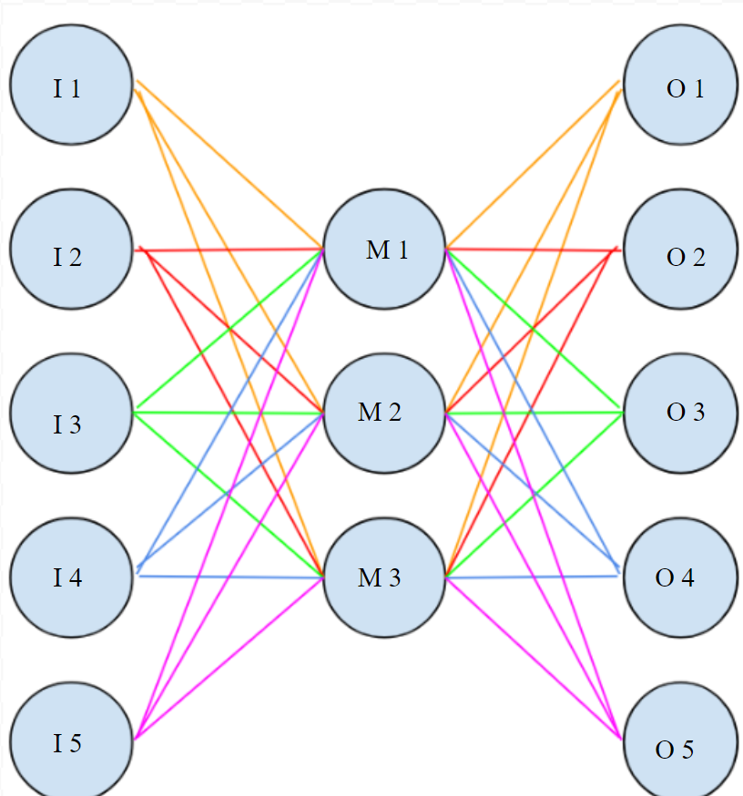
What is a neural network
A neural network is a series of “nodes” (Blue circles in the diagram on the right) in multiple “layers”
Each node feeds an input to the next node by some linear formula
Each node is connected to each node in the next layer and gets input from all nodes in the previous layer

Slide 3
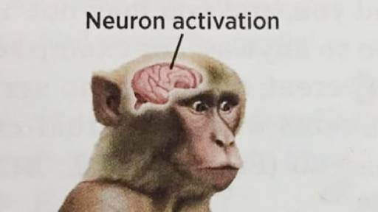
So you’re completely lost and didn’t understand the previous slide
A neural network is trying to reproduce how the human brain works.
100 billions neurons are firing off inside your brain to make you want to go on your phone and not listen to our presentation.

Slide 4
Why do we need neural networks?

Slide 5
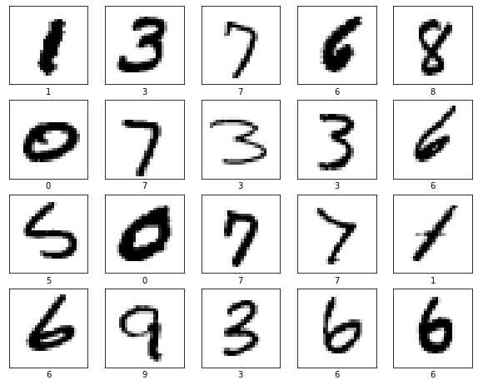
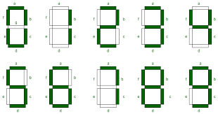
How would you tell a 3 year old how to label these values?
Hopefully, every person in this room can label these numbers from the hand drawn image. If you were going to explain how you labeled them, what would you say? Maybe that the top left image was just a line and therefore it was a one. You could describe each number as a seven segment display shown in the bottom right corner. But how would you explain “poorly drawn” numbers like the 5 in the dataset? We can all recognize the numbers from the dataset because we have seen billions of numbers in our lives. So, we “teach” neural networks the same way by training them with labeled examples. Using a neural network is one of the only ways to program image recognition.

Slide 6
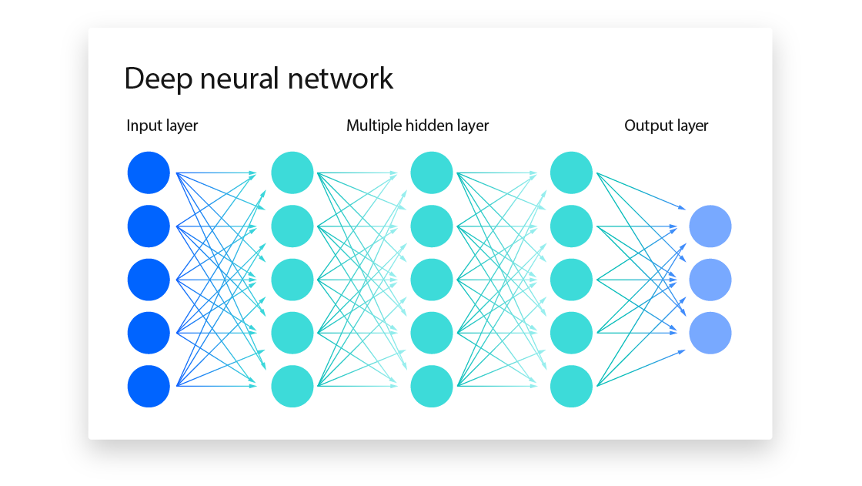
What’s the goal?
The end goal is to get the final layer to each correspond to a different number. The idea is that each neuron in the end layer represents a number. The value of each neuron represents the probability of that number being the answer.
The entire point of machine learning is to calculate each neuron step and to optimize the weights and biases of each neuron to optimize this calculation with each successive iteration

Slide 7
Isn’t this presentation supposed to be about linear algebra and not computer theory???

Slide 8
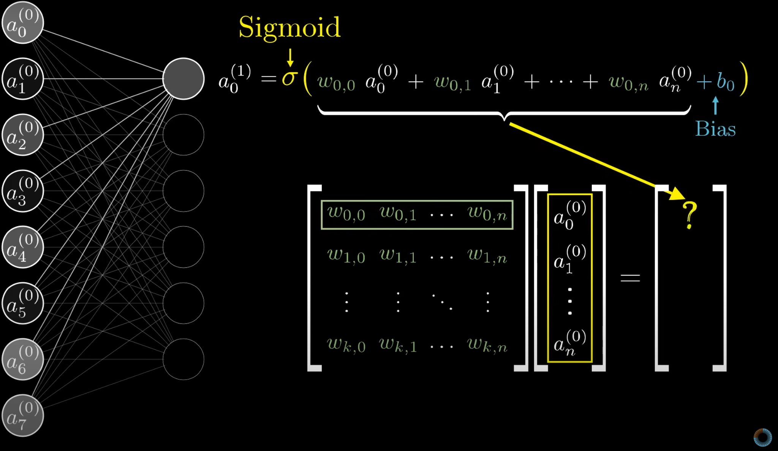
How to calculate one “step” in the network. How is this linear algebra?
Source:
3Brown1Blue

Slide 9
Connections!
Remember our original goal of getting each subsequent neuron a value that represents a certain conglomeration of pixels?
We can write a vector of each neuron representing the weights and biases from each of its connections.
W⋅d+b
⋅ +
d
w₁
w₂
…
w_{n}
d₁
d₂
…
d_{n}
b₁
b₂
…
b_{n}
w
d
w
w
d

Slide 10
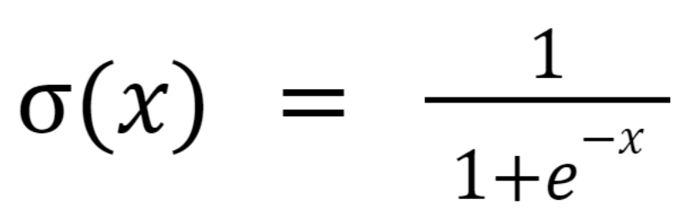
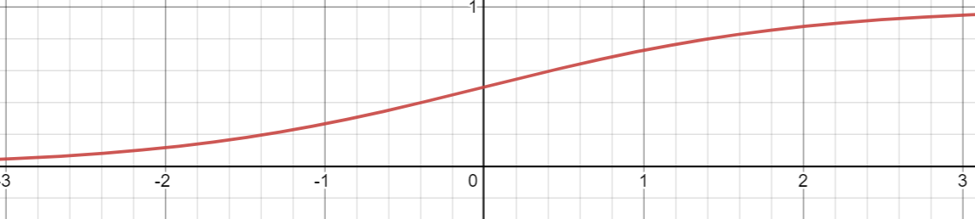
Sigmoid function?
Clamps values in (-INF, INF) to (0,1)
Important for maintaining probabilities
o(W⋅d+b) is actual formula for each node

Slide 11
OK BUT WHERE'S THE AI???????????
YOu lied to us!!!

Slide 12

Deep Learning or: How I Learned to Stop Worrying and Love the Linear Algebra
We need a way to tell our algorithm to adjust the weights and biases
For this, we define a “cost” function
V is the vector of answers in the output layer, A is the vector of expected correct answers
A lower cost means a better system

Slide 13
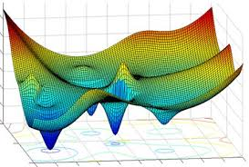
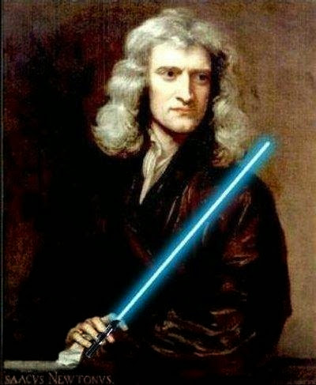
Gradient Descent
Assume the graph to the right is our weights to cost graph This graph is assuming a weight vector in R^2
Similarly, finding a vector W that yields the lowest possible Cost will give us a system of weights and biases will return the best optimized system
We will use a system to find this called Newton’s method – just in the 99999th dimension of our weight vector

Slide 14
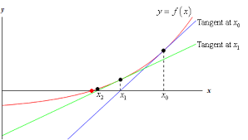

Newton’s method
The formula for the 2D Newton’s method is: Y = dY/dX * X X = X_{I} + X And we just continually iterate that until Y = 0
Here, we must substitute Y for our Cost function, C. Our X will be our weights/bias vector, W.
In higher dimensions, it’s very similar but a bit different:

Slide 15




Jacobian Method
First, we calculate the gradient of our Cost function (the change of our cost in a direction):
Then each row of the Jacobian is a different gradient for each cost in a layer our input neurons
Which leads us to, . This is very similar to setting
We can rearrange,

Slide 16
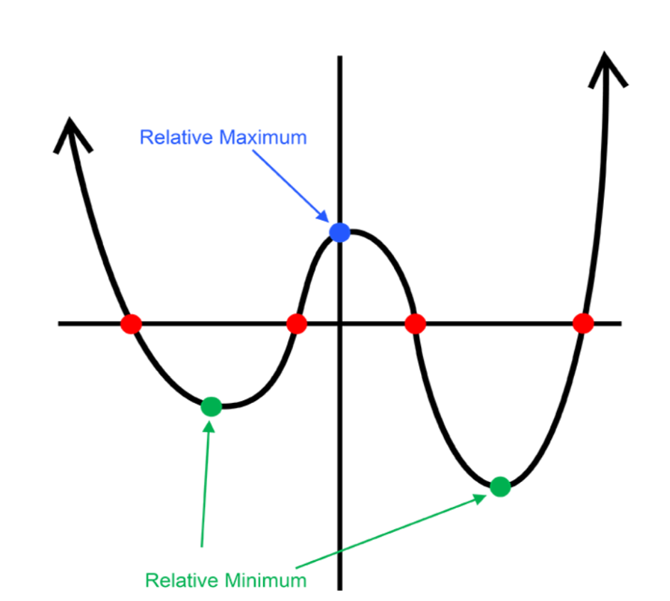
Limitations
This method often runs into the problem of dropping into local minimums (talk about a graph of my life)
Needs lots of data to continually adjust weights and biases to correct amounts
Very energy intensive

Slide 17
Questions?

